Slide 1
CREATIVITY AND INNOVATION
Creativity is seeing what everyone else has seen and thinking what no one else has thought." — Albert Einstein

Slide 2
Introduction
Creativity refers to the creation of a valued, useful unique product, service, idea, procedure, or process by individuals working together in a combined social system. It’s the ability to think differently, envision opportunities and create something new.
Entrepreneurs use creativity to identify unmet needs, develop unique products or services, and design innovative business models.
The modern business operates in a world of galloping change which creates new problems, risks and opportunities and for which entrepreneurs have to mobilize the enterprise’s resources before changes makes their impact felt.
Innovation is defined as the process of implementing creative ideas into practical, valuable, and marketable products, services or processes.
All innovation begins with creative ideas. Creativity is therefore the starting point for innovation. Innovation is the implantation of creative ideas or inspirations.

Slide 3
Creativity: “The Foundation”
Entrepreneurs become more creative by being motivated by interests, satisfaction, and challenges of a certain situation. Within every individual, creativity is a function of three components as;
i). Expertise as it encompasses everything that a person knows and can do in the broad domain of hisor her work- knowledge and technical ability.
ii). Critical thinking skills as it refers to how you approach problems and solutions- the capacity to put existing ideas together in new combinations. The skill itself depends quite a bit on personality as well as on how a person thinks and works.
Expertise and creative thinking are the entrepreneur’s raw materials or natural resources.
iii). Motivation as it’s the drive and desire to do something, an inner passion and interest. When people are intrinsically motivated, they engage in their work for the challenge and enjoyment of it. The work itself is motivating. People will be most creative when they feel motivated primarily by the interest, satisfaction and the challenge of the work itself.
The creative process is the act of solving problems through innovation. It is a systematic approach to solving problems by finding new ways of looking at old concepts. This system can be executed by an individual or a team of people for personal, educational, or business purposes. It’s described as follows;

Slide 4
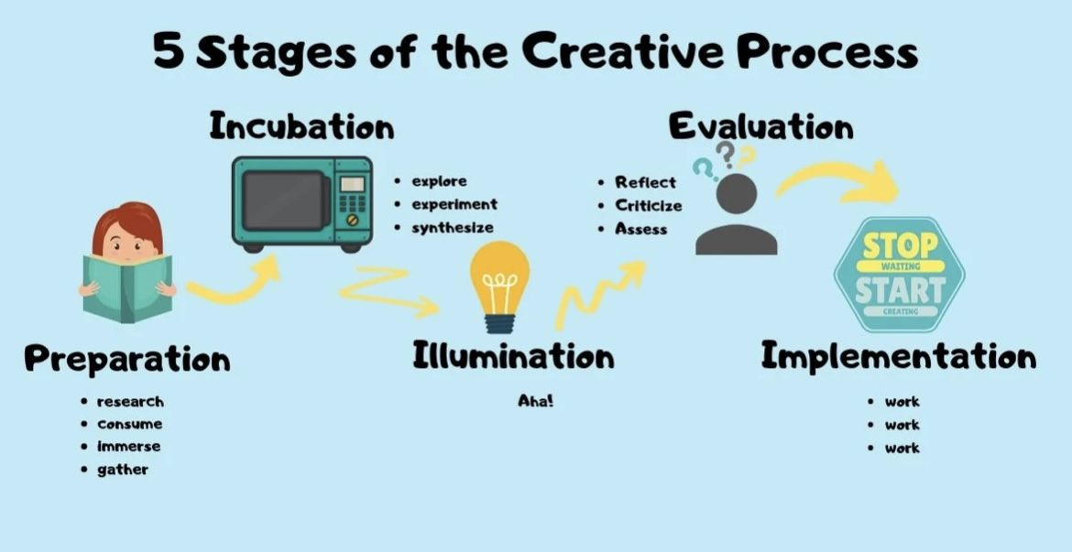
The Creative process;

Slide 5
Importance of creativity
The following are some of the importance of creativity in the workplace;
i). Creative thinking allows entrepreneurs to find unique and effective solutions to these problems thus problem solving.
ii). Adaptability as creativity enables entrepreneurs to adapt to changing market conditions, customer preferences, and industry trends
iii) In a crowded market, creativity helps businesses differentiate themselves by offering something distinctive, which can attract customers and investors.
iv) Creative entrepreneurs can create a competitive advantage by continuously coming up with new and improved offerings that keep customers engaged and loyal
v) Creativity is vital in crafting compelling marketing campaigns and building a strong brand identity, both of which are crucial for attracting and retaining customers

Slide 6
INNOVATION
Innovation is the process that transforms new ideas into new value- turning an idea into value. You cannot innovate without creativity. Innovation is the process that combines ideas and knowledge into new value. Without innovation an enterprise and what it provides quickly become obsolete.
Innovation has got four types and they are as follows;
invention – the creation of a new product, service or process, often one that is novel or untried; such concepts tend to be revolutionary
﻿﻿extension - the expansion of a product, service or process already in existence; such concepts make a different application of a current idea
﻿﻿duplication - the replication is of an already existing product, service or process; the duplication effort, however, is not simply copying but adding the entrepreneur's own creative touch to enhance or improve the concept to beat the competition
﻿﻿synthesis - the combination of existing concepts and factors into a new formulation; this involves taking ideas or items already invented and finding a way so together they form a new application.

Slide 7
The importance of Innovation
The following are some of the importance of innovation in the business environment;
i). Thinking innovatively or creatively can help managers and executives develop unique marketing campaigns to help them stand out. Thus creating a competitive advantage.
ii). Also, one of the biggest advantages of innovation is that it helps increase revenue and market shares. Subsequently, leading to a reduction in cost.
iii). Brings uniqueness and novelty to business process
iv) Innovation helps the firm long to take advantage of new technology: Thus new technologies for process/ product innovation enables to optimize the business and gain competitive advantages over competitors
v) It helps organizations grow in complex situations such as the COVID-19 pandemic.
vi) It also helps to solve complex business problems.

Slide 8
Creativity vs Innovation
Differences between Creativity and Innovation
CREATIVITY | INNOVATION
Involves the generation of novel and useful ideas. | Entails the implementation of these Ideas into new products and processes.
Creativity is a mental process and can occur in any context, not necessarily limited to a specific field or industry. | Innovation is typically goal-oriented and aims to address specific challenges, improve efficiency, or meet market demands.
It often focuses on the generation of ideas and doesn't necessarily require those ideas to be implemented. | It often involves a systematic process of development, testing, and implementation to create real-world impact.
It is harder to measure | Can be easily measured

Slide 9
References
References
Kuratko D. F and Hodgetts R, M (2011), Entrepreneurship – A Contemporary Approach; Harcourt Inc
•Kuratko D. F and Hodgetts R, M (2014), Entrepreneurship, Theory Process and Practice, Thomson Learning.
Group members
TAMALA. S ABDALLAH IMC/BAIT/2111191
MASURA H. TEWELE IMC/BAIT/2111681
ALEXANDER A. NATAI IMC/BAIT/2121154

Slide 10
THANK YOU

